Slide 1

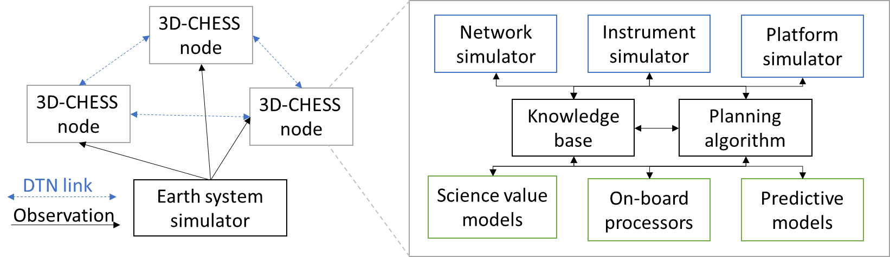
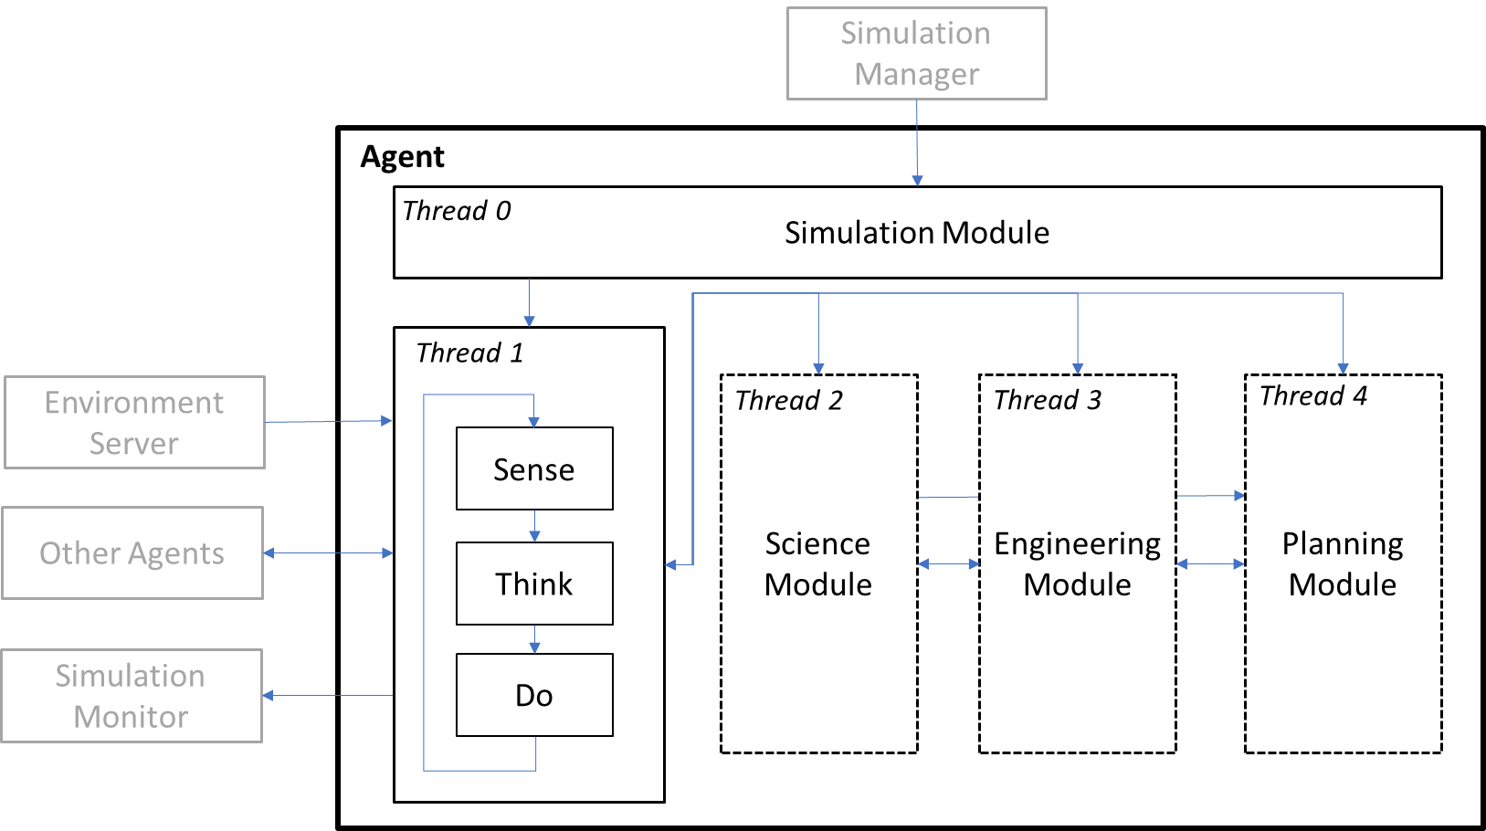






Env-to-agent
Sensing Data
Peer-to-peer
Data or Requests
Satellite Agent
Environment Server
Manager broadcast
Sim start, end, or time
Satellite Agent
Peer broadcast
Data or Requests
Results Logger
Simulation Manager
Node Results
Node state, actions performed, events detected/measured, etc.
UAV Agent
Ground Station Agent

